Slide 1
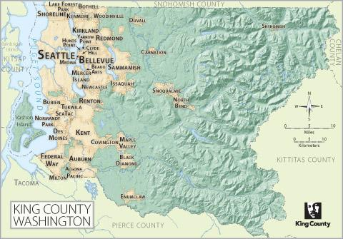
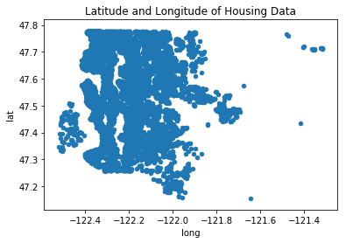
Kings County, Wa
Housing Data

Slide 2
What is our Purpose?
Primary
To build a model that can predict the selling price of a house based on data that can be collected.
Secondary
Attempt to understand the housing market and how homeowners can improve the value of their home.

Slide 3
The Model
Latitude
Longitude
Number of Bedrooms
Size in Square-feet
Grade
Waterfront

Slide 4
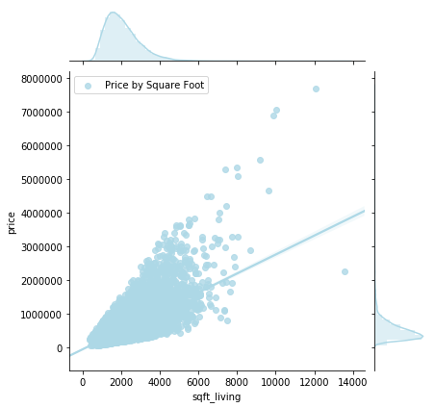
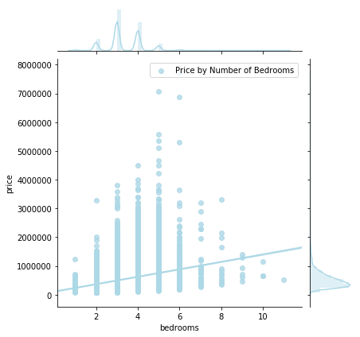
The Results
Notes:
The second model I created has an r-squared value of 0.719. This means that 71.9% of our data can be predicted by our model. While this seems like a high number, if we run multiple predictions, It shows that our model is still a little off.
Three examples of significant predictors for this data set are sqft_living, waterfront (specifically, if it is on the water front) and latitude/longitude.
Sqft_living has a positive coef which means that as sqft_living increases so does the selling price. This is also the case with waterfront. If the house is on the waterfront, that will significantly increase the final selling price.
Latitude and Longitude are interesting variables because they give us an idea of space a well. Long has a slight negative coef, and Lat a slight positive. This means that as we travel north east through the region, the houses will become more expensive.
For further investigation I would like to:
see if I can improve the linearity of the Grade data as this seems to be a great predictor of price
increase the data from the waterfront category since this is highly predictive(even with only 146 waterfront properties and 2376 missing data points
I would like to explore a way for a more meaningful longitude/latitude analysis. Since I took the Z-score, the data reflects standard deviations from the mean (Mercer Island). This does really a great predictor. I would be interested in seeing if the price of housing varied in a linear fashion based on the distance from major sporting arena's or Amazon/Starbucks headquarters for example.

Slide 5
